Slide 1
WUXI GSPV NEW ENERGY CO ., LTD. www.gspvenergy.com +86 0510 8516 8906

Slide 2
Company profile
Wuxi GSPV New Energy Co., Ltd was established in 2002, as a provider of high-quality solar modules for both residential rooftops and large-scale power station projects.
Our product range includes
PERC solar module TOPCon solar module HJT solar module
from 365W to 670W from 420W to 700W from 380W to 720W
With our solar modules, you can rely on a clean and sustainable energy solution that not only benefits the environment but also offers significant cost savings over the long term.
We have a reliable network of manufacturing partners, ensuring consistent quality and timely delivery of our products to meet the demands of our customers.
Our team is always ready to assist our clients with any inquiries or concerns that may arise before, during, or after the purchase. We believe in building long-term partnerships with our clients, and your satisfaction is our utmost priority.
one 01
Email：canjkb@gspvenergy.com Website：www.gspvenergy.com

Slide 3
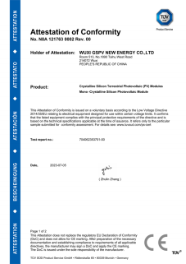
Management System
ISO 9001 |  |  |  |  |  | CE
ISO 14001
TUV
two 02
Email：canjkb@gspvenergy.com Website：www.gspvenergy.com

Slide 4
Factoy Capacity
Factoy Area
30,000SQM
Annual Capacity
2000MW
Module Type
166/182/210
Employee Number
280
three 03
Email：canjkb@gspvenergy.com Website：www.gspvenergy.com

Slide 5
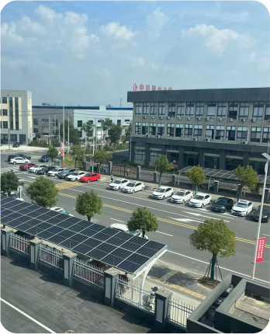
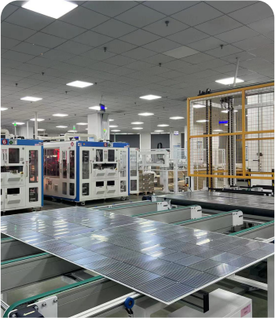
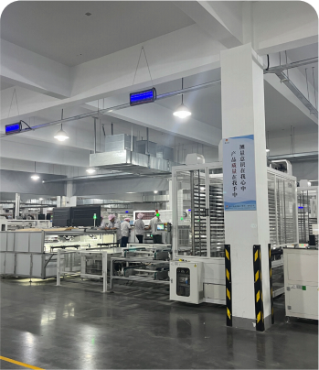
Factory Overview
Factory Overview
Factory Inside
Factory Inside
Factory Inside
four 04
Email：canjkb@gspvenergy.com Website：www.gspvenergy.com

Slide 6
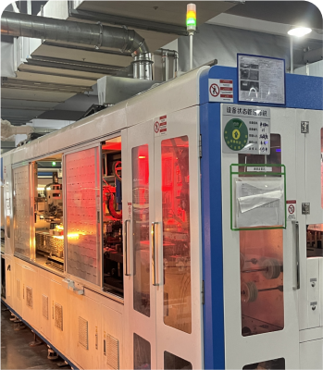
Advanced Equipment
Tabber Stringer
EVA Cutter
Automatic Lay-up Machines
five 05
Email：canjkb@gspvenergy.com Website：www.gspvenergy.com

Slide 7
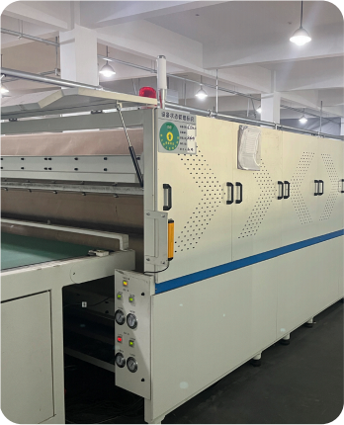
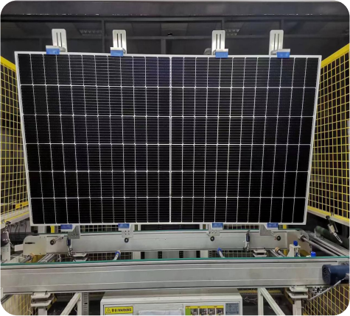
Advanced Equipment
Laminator
EL Tester
Visual Inspection
six 06
Email：canjkb@gspvenergy.com Website：www.gspvenergy.com

Slide 8
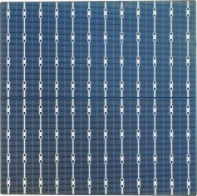
Solar Cell Product
Front
Front
Front
Back
Back
Back
Monocrystalline 182-10BB
Bifacial Solar Cell
TOPCON 182-18BB
Bifacial Solar Cell
Monocrystalline 210-12BB
Bifacial Solar Cell
Eff：22.2%-23.3%
Eff：23.3%-24.7%
Eff：22.1%-23.1%
seven 07
Email：canjkb@gspvenergy.com Website：www.gspvenergy.com

Slide 9
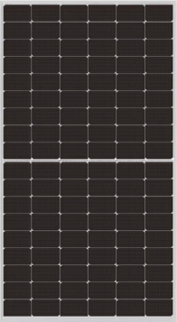
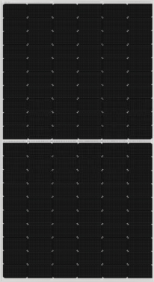
182 Mainstream Model
GSPV- M10/108H-395W-415W P-Type
GSPV- M10/120H-450W-470W P-Type
GSPV-M10/144H-535W-555W P-Type
eight 08
Email：canjkb@gspvenergy.com Website：www.gspvenergy.com

Slide 10
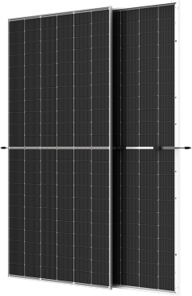
210 Mainstream Model
GSPV- M12/144H-415W-440W P-Type
GSPV-M12/120H-590W-610W P-Type
GSPV-M12/132H-650W-670W P-Type
nine 09
Email：canjkb@gspvenergy.com Website：www.gspvenergy.com

Slide 11
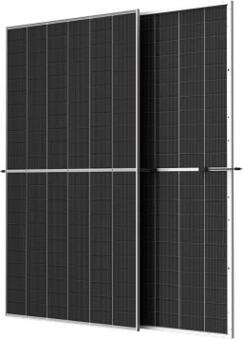
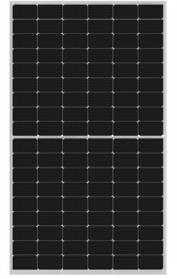
TOPCon Mainstream Model
GSPV-M10/108H-425W-445W N-Type
GSPV-M10/144H-570W-590W N-Type
GSPV-M12/132H-675W-700W N-Type
ten 10
Email：canjkb@gspvenergy.com Website：www.gspvenergy.com

Slide 12
HJT Mainstream Model
GSPV-M10/108H-430W-450W HJT
GSPV-M12/120H-625W-645W HJT
GSPV-M12/132H-700W-720W HJT
eleven 11
Email：canjkb@gspvenergy.com Website：www.gspvenergy.com

Slide 13
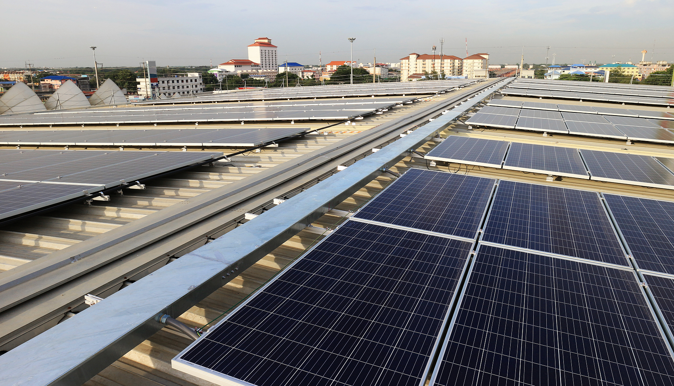
Project Cases
Romania 5MW Solar Project
Chile 8MW Solar Project
Yuecheng 4MW Solar Project
Ningxia 10MW Solar Project
Tianjin 5MW Solar Project
Yancheng 8MW Solar Project
twelve 12
Email：canjkb@gspvenergy.com Website：www.gspvenergy.com

Slide 14
Contact Us
Address
Office: NO.518 Taihu Pearl Development Mansion NO.1890 Taihu West Road, Wuxi. Jiangsu. China
Factory: LongXi Road, ZhuLin Town, Jintan District, ChangZhou City, JiangSu Province, China
Phone
Hotline: +86 510 8516 8906
Mobile: +86 18921289906
WhatsApp
+86 18921289906
FAX
FAX: +86 510 8516 8988
Changzhou
Wuxi
Hong Kong
Sydney
Email
canjkb@gspvenergy.com
www.gspvenergy.com
Facebook
Linkedin
Website

